Slide 1


A
Project Review Presentation on
Enhanced Skin Cancer Detection through
Ensemble Machine Learning
Deep Navle(121B1D015) Pankaj Kaname(121B1D016) Om Mahajan (121B1D034) Rohan Patil(121B1D036)
(A. Y. 2024-25)
Under the guidance of
Prof. Minal Shahakar
Department of Computer Engineering(Regional Language)
PCET’s Pimpri Chinchwad College of Engineering

Slide 2

Contents
Problem statement
Introduction
Motivation
Objectives
Project Requirement
Literature Review
Proposed Methodology
Algorithms
Results
Conclusion
Paper Publication
References

Slide 3
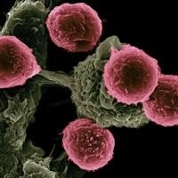
Problem Statement
Delayed detection of skin cancer reduces survival rates, and manual diagnosis is time-consuming and prone to errors. An automated and accurate detection system is needed for early diagnosis and better treatment outcomes

Slide 4
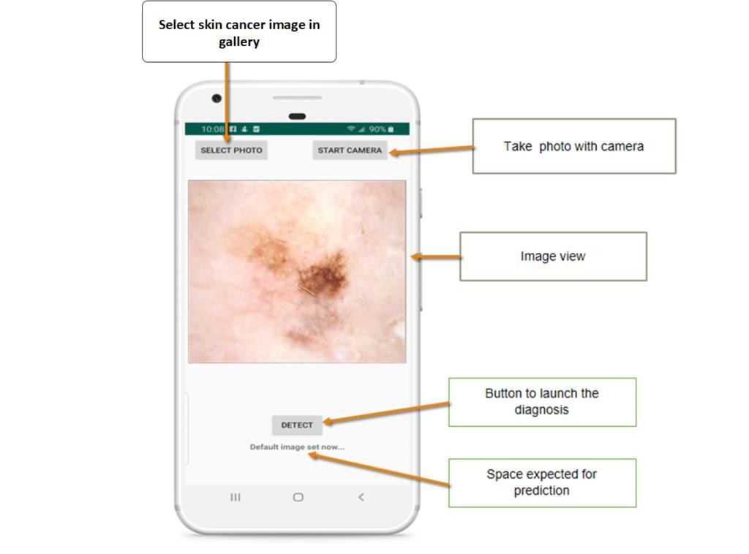
Introduction
Automated skin cancer detection using machine learning for early diagnosis.
Employs image analysis, feature extraction, and ensemble classifiers.
Aims to provide fast, reliable screening for healthcare support.

Slide 5
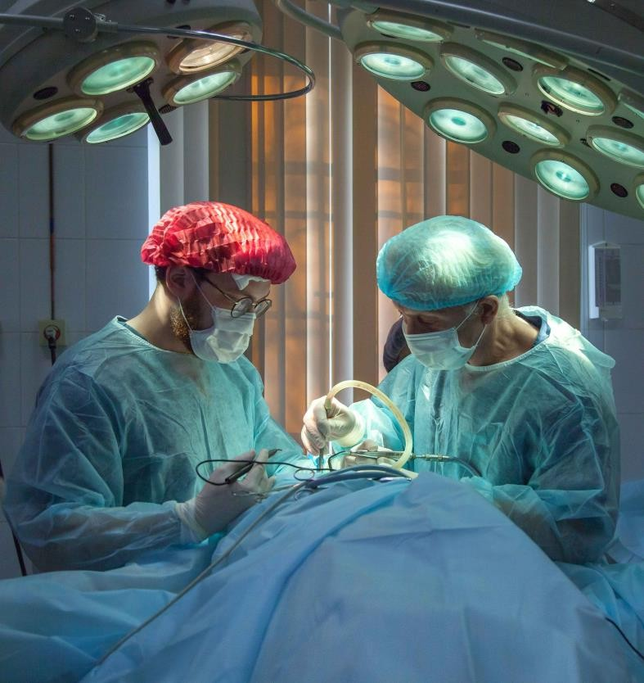
Motivation
Rising skin cancer cases need efficient
detection methods.
Manual screening is slow and error- prone.
AI offers quick, accurate, cost-effective solutions.
Early detection improves survival and
healthcare access.

Slide 6

OBJECTIVES
Help users detect skin cancer just by uploading an image
Use a trained computer model that gives fast and accurate results
To detect different types of skin cancer
To support early diagnosis

Slide 7
Project Requirements
S/W Requirements:
Python, Flask, TensorFlow/Keras, OpenCV,SQLite,HTML,CSS
Jupyter Notebook/VS Code
Weka tool
H/W Requirements:
GPU-enabled system
Minimum 8 GB RAM, 10 GB free storage

Slide 8
Functional Requirements:
Image preprocessing and augmentation
Skin lesion classification and prediction
Visualization of results
Non-Functional Requirements:
High accuracy and efficiency
Scalability for large datasets
User-friendly interface

Slide 9
Literature Review
Reference 1 | S. D. Thepade and A. Aher, "Machine Learning Based Melanoma Skin Cancer Identification Using Feature Fusion of Thepade's TSBTC and Bernsen Thresholding," 2022 International Conference on Signal and Information Processing (IConSIP), Pune, India, 2022, pp. 1-6, doi: 10.1109/ICoNSIP49665.2022.10007471.
Objectives | Develop a machine learning method for identifying melanoma skin cancer using feature fusion techniques.
Proposed Solution | Feature Extraction: Global features: Thepade's SBTC (Symmetric Binary Ternary Color) technique Local features: Bernsen Thresholding Feature fusion of global and local features Dataset: Melanoma dataset from Kaggle 1000 images (500 benign, 500 malignant) Classification: Used 12 machine learning classifiers,4 ensemble classifiers,10-fold cross- validation
Results | Highest accuracy: 86.67% (Ensemble of Random Forest + Multilayer Perceptron + Logistic Regression) Sensitivity: 0.86 Specificity: 0.91
Advantages | Combines global and local feature extraction Provides more accurate melanoma identification compared to individual feature extraction methods Uses multiple classifiers for robust prediction
Limitations | Relies on specific feature extraction techniques Performance may vary with different datasets

Slide 10
Reference 2 | Indraswari, Rarasmaya, Rika Rokhana, and Wiwiet Herulambang. "Melanoma image classification based on MobileNetV2 network." Procedia computer science 197 (2022): 198-207.
Objectives | The objective of this paper is to propose a method for classifying melanoma images into benign and malignant classes using with MobileNetV2 as the base model.
Proposed Solution | The proposed solution involves pre-training MobileNetV2 on the ImageNet dataset. Add head layers to MobileNetV2: global pooling, two fully-connected layers with ReLU activation, and an output layer for class prediction using softmax activation. Train the head model while freezing base model weights, using Adam optimizer Employ data augmentation (rotation, flip, zoom, shift) to enhance model generalization and performance
Results | The proposed method achieved up to 85% accuracy on the dataset, showing promise for melanoma classification. Overfitting was not observed, indicating good generalization ability. MobileNetV2 outperformed other base models in accuracy and efficiency.
Advantages | The utilization of transfer learning with a pre-trained MobileNetV2 base model enhances melanoma image classification by leveraging knowledge from a large dataset.
Limitations | The dataset imbalance can lead to lower specificity in classifying malignant lesions, potentially resulting in false positive classifications.

Slide 11
Reference 3 | Mahmud, Faysal, et al. "An Interpretable Deep Learning Approach for Skin Cancer Categorization." arXiv preprint arXiv:2312.10696 (2023).
Objectives | This paper aims to improve skin cancer detection using modern deep learning and explainable AI techniques.
Proposed Solution | Preprocess skin lesion images by resizing and labeling, then augment training data for improved generalization. Train XceptionNet, EfficientNetV2S, InceptionResNetV2, and EfficientNetV2M models with optimized configurations and learning rates. Evaluate model performance using metrics like accuracy, recall, precision, and F1-score to determine the most effective model for skin cancer detection.
Results | XceptionNet achieved the highest accuracy of 88.72%, followed closely by EfficientNetV2S with 88.02%. InceptionResNetV2 and EfficientNetV2M achieved slightly lower accuracies of 85.73% and 85.02%, respectively.
Advantages | Pre-trained deep learning models like XceptionNet and EfficientNetV2S achieve high accuracy rates (88.72% and 88.02% respectively) for skin cancer image classification.
Limitations | Despite achieving high accuracies, the computational complexity of these models may pose challenges in terms of deployment in resource-constrained environments or real-time applications.

Slide 12
Reference 4 | Shah, Aarushi, et al. "A comprehensive study on skin cancer detection using artificial neural network (ANN) and convolutional neural network (CNN)." Clinical eHealth (2023).
Objectives | The objective of this study is to review recent advancements in skin cancer detection using artificial neural networks (ANN) and convolutional neural networks (CNN).
Proposed Solution | This study aims to review recent advancements in using Machine Learning and Advanced Technologies for Skin Cancer Detection. Systematic literature search conducted across various databases, filtering studies based on relevance. Exploration of machine learning algorithms like SVM, KNN, Decision Trees, LSTM, ANN, and CNN for skin cancer detection, with emphasis on recent studies and their methodologies.
Results | CNN Accuracy: Achieved an accuracy of 95.40%. ANN Accuracy: Attained an accuracy of 86.3%.
Advantages | Deep learning techniques like ANN and CNN offer high accuracy in skin cancer detection, potentially leading to earlier diagnosis and improved treatment outcomes.
Limitations | Implementing deep learning models such as CNN can be complex and require technical expertise, while also demanding large amounts of labeled data for training, and facing challenges in standardization of data collection methods.

Slide 13
Reference 5 | Raval, Dhatri, and Jaimin N. Undavia. "A Comprehensive assessment of Convolutional Neural Networks for skin and oral cancer detection using medical images." Healthcare Analytics 3 (2023): 100199.
Objectives | The paper proposes a deep learning approach for skin and oral cancer detection using CNN models and image processing techniques.
Proposed Solution | The paper applies CNN to a dataset of skin lesions, employing preprocessing techniques like image resizing, augmentation, and filtering to enhance model training and accuracy. Techniques like image normalization and segmentation aid in standardizing data and identifying specific features for better classification.
Results | Various CNN models, including AlexNet, VGGNet, ResNet, and DenseNet, were trained and compared for skin cancer detection. DenseNet outperformed other models in terms of accuracy and loss, showcasing superior performance in skin cancer classification.
Advantages | Image thresholding is effective for removing hair structures that differ significantly in color intensity from the surrounding skin, simplifying the image and improving clarity.
Limitations | Morphological techniques might inadvertently remove important details along with noise, potentially compromising the integrity of the image and affecting subsequent analysis.

Slide 14
Summary of Literature Review
Various machine learning and deep learning techniques have been explored for skin cancer detection. The key findings from reviewed papers are:
CNN-based models outperform traditional approaches.
Ensemble models (e.g., DCENSnet, OESV-KRF) improve classification by combining multiple algorithms.
Feature extraction techniques (e.g., GLCM, RDWT) enhance model performance.
Transfer learning (e.g., MobileNetV2) speeds up training and improves accuracy.
Challenges: Dataset imbalance, computational complexity, and generalizability issues.
AI-driven approaches, particularly CNNs and ensemble learning, significantly improve skin cancer detection, but further research is needed for real-world deployment and better dataset standardization.

Slide 15

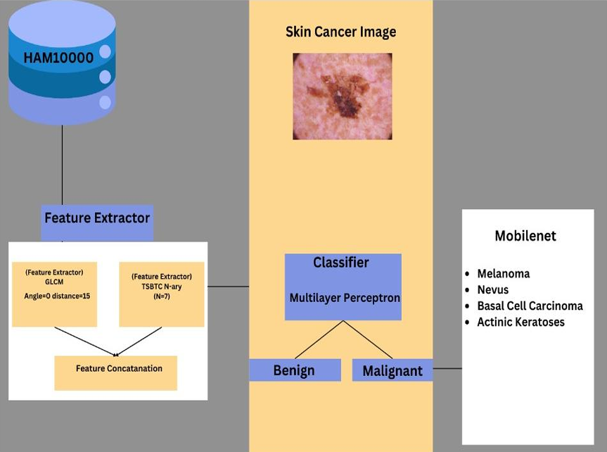
Flowchart of Proposed Method:

Slide 16
STEPS OF EXECUTION:
Step 1. Take a skin lesion image as the input image.
Step 2. Feature Extraction:
2.1 Extract features from finetuned GLCM.
2.2 Extract TSBTC 7-ary features.
Step 3. Concatenation of both features.
Step 4. Training Machine Learning classifiers.
Step 5. Testing.
Step 6. Classification Result.
Step 7. Benign / Malignant
Step 8. If Malignant, detect type of cancer

Slide 17
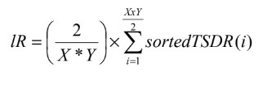
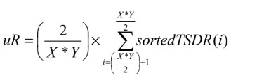
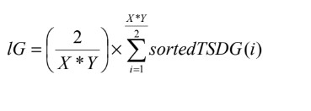


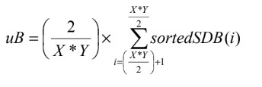
ALGORITHM USED:
TSBTC

Slide 18
GLCM
Correlation
Contrast
Energy
Dissimilarity
Homogeneity
ASM

Slide 19
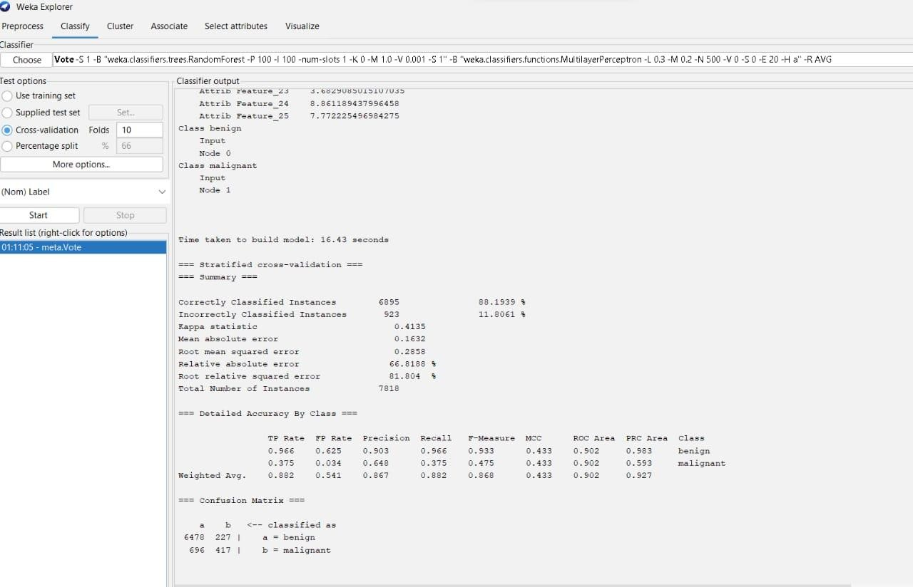

Slide 20

Result

Slide 21
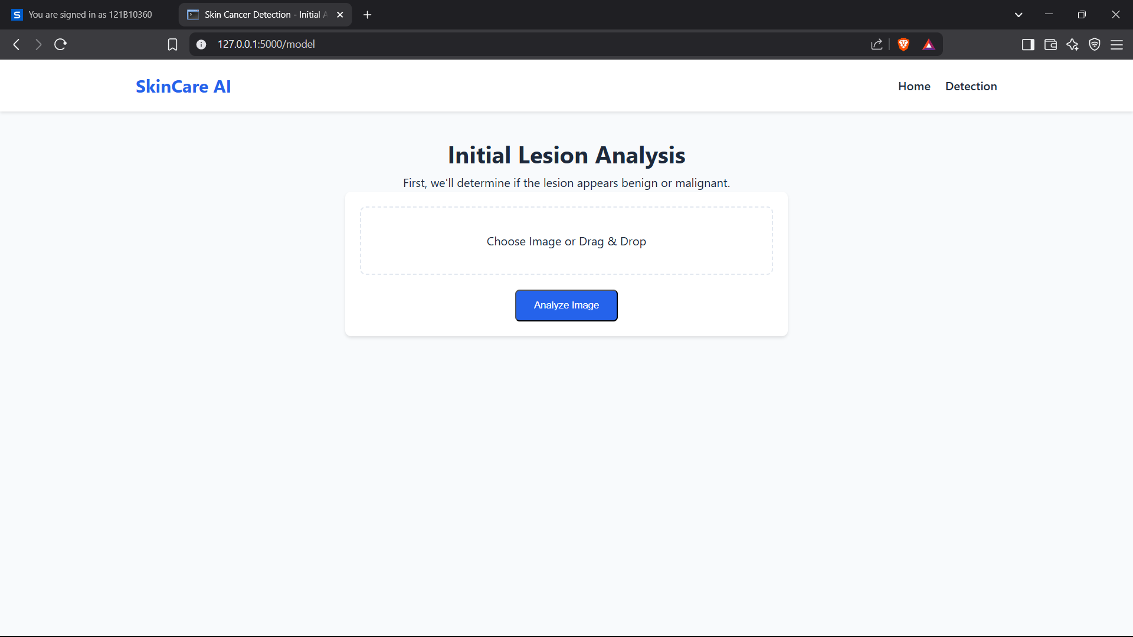

Slide 22
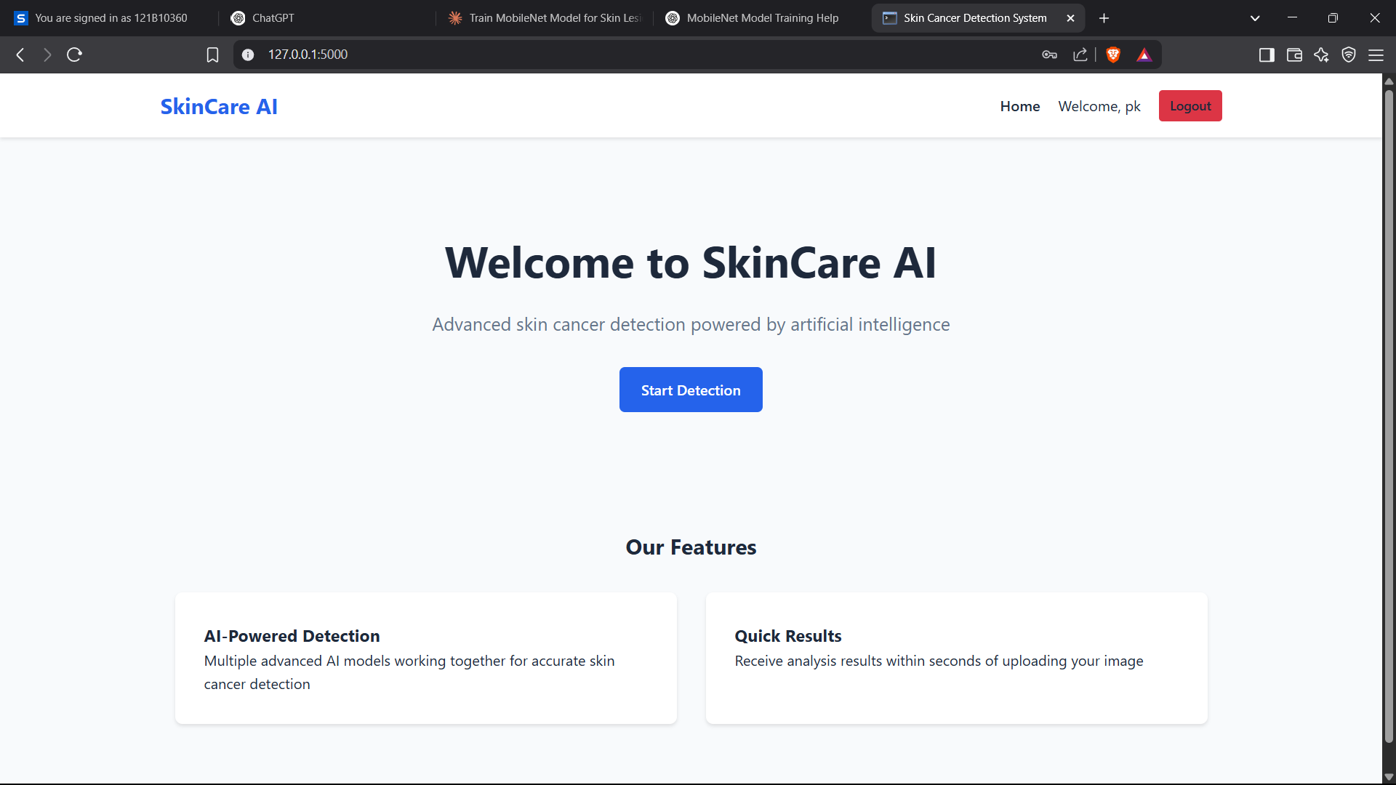

Slide 23
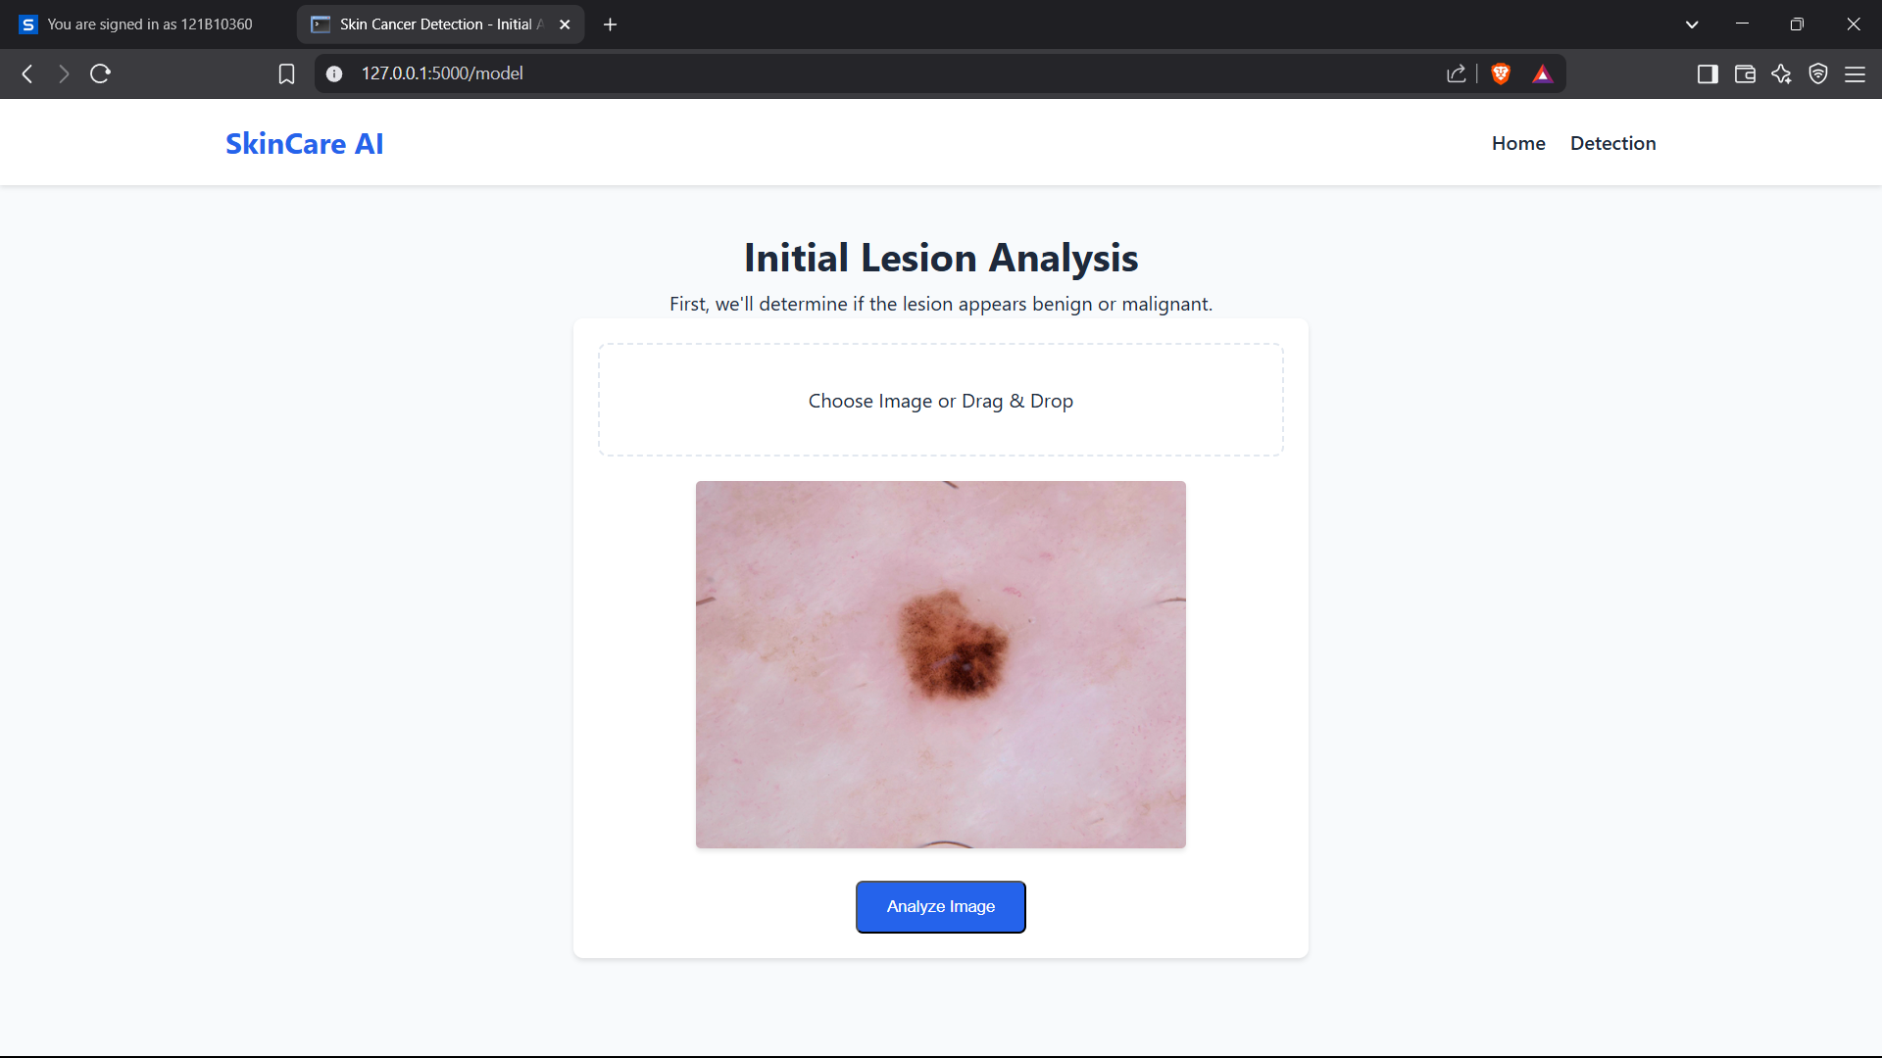

Slide 24
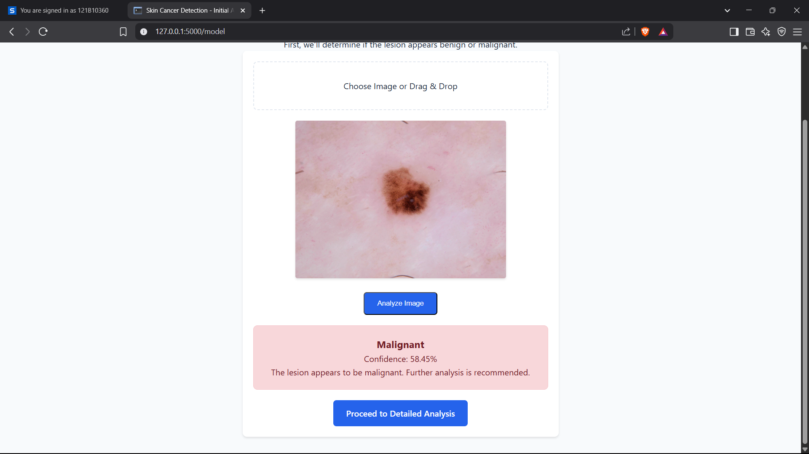

Slide 25
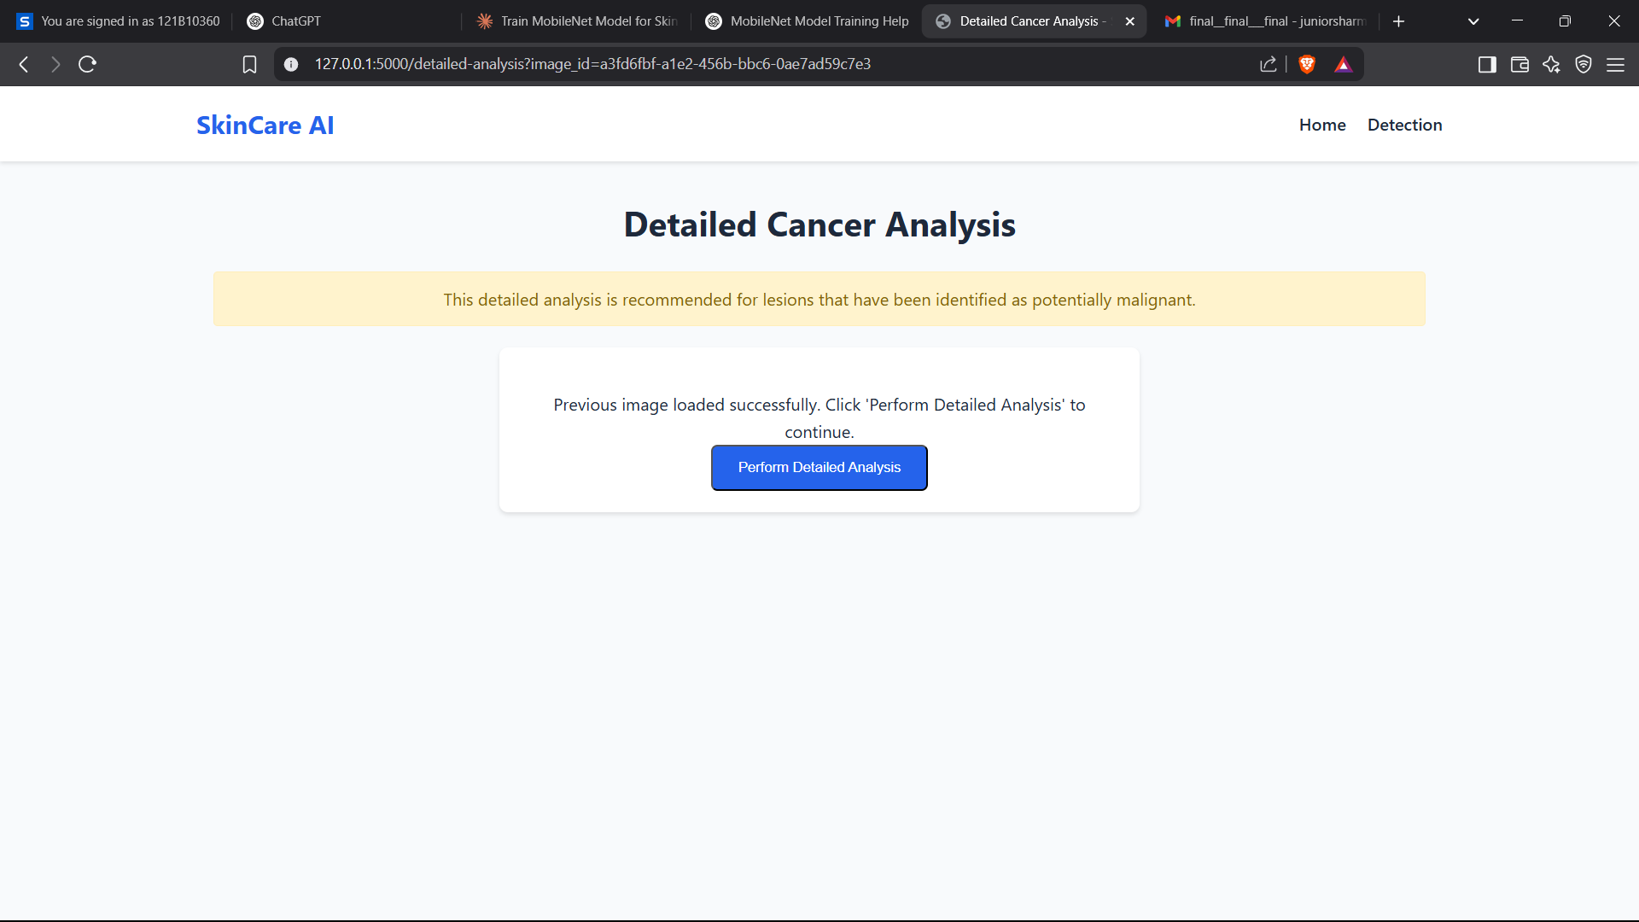

Slide 26
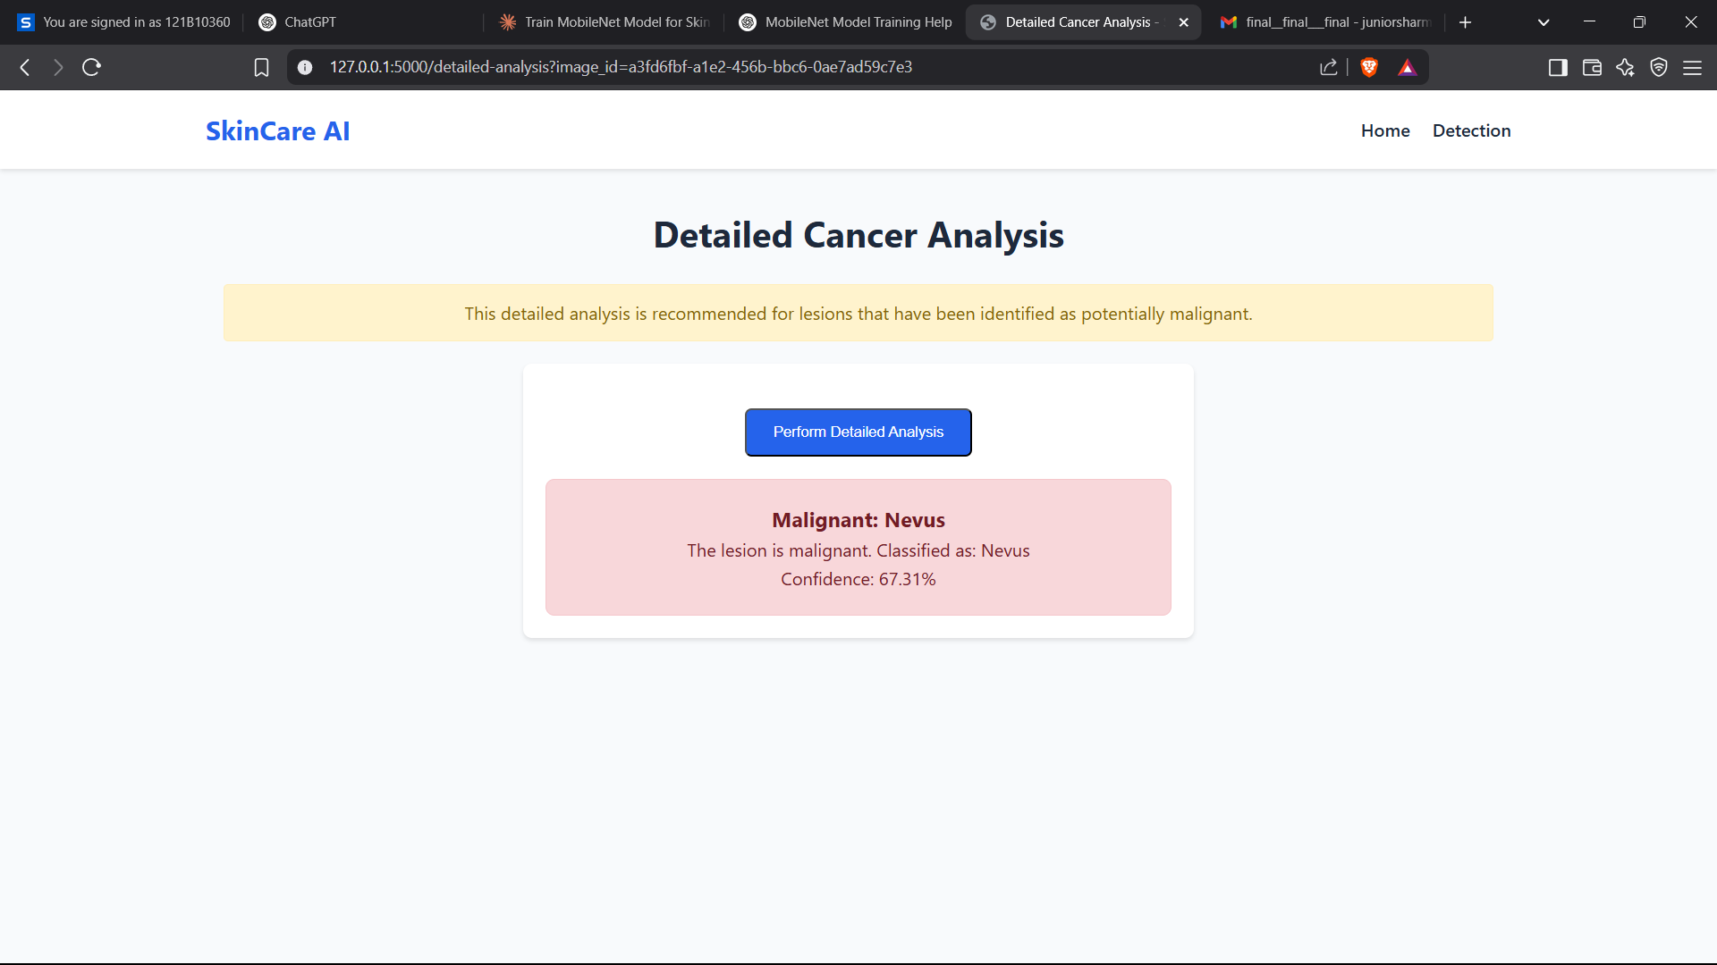

Slide 27
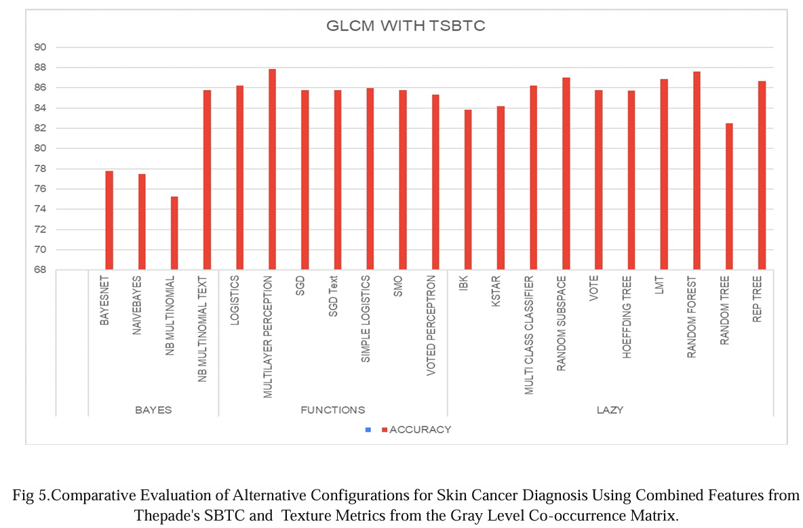

Slide 28
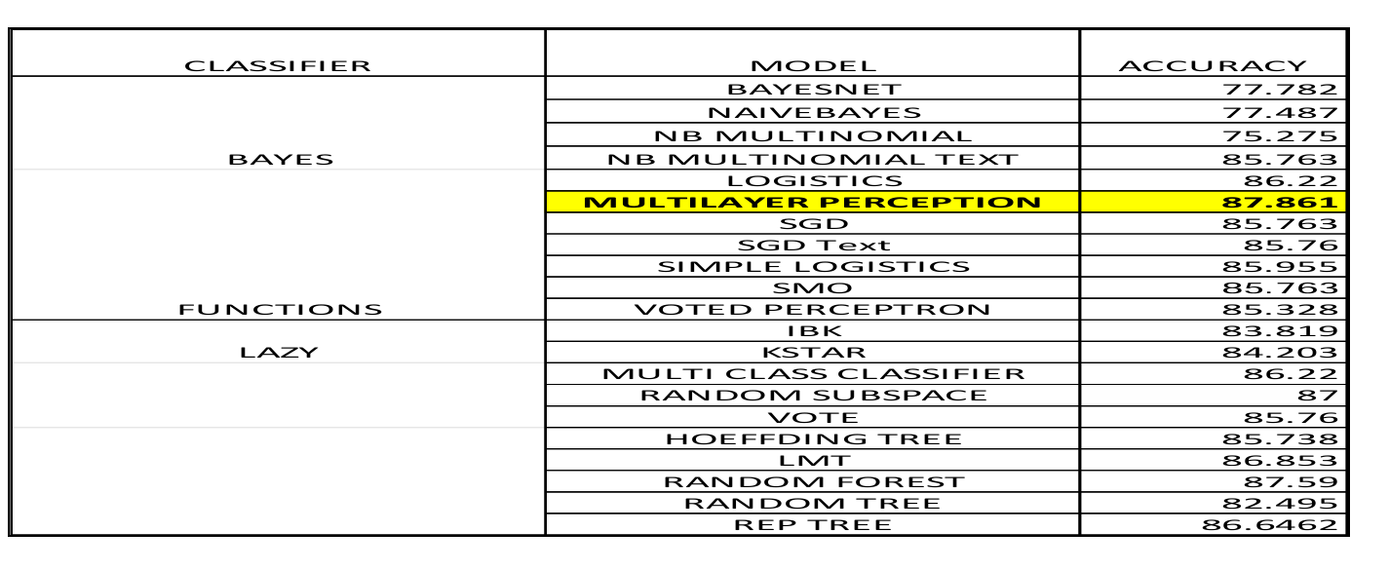

Slide 29
Conclusion
Our system successfully implements a multi-stage skin cancer detection system combining binary classification and detailed cancer type analysis. The project integrates secure user authentication, efficient image processing, and web interface to provide accessible dermatological pre-screening.

Slide 30
Paper Publication Details
Title of Paper: Enhanced Melanoma Skin Cancer Detection through Ensemble of Thepade's SBTC and GLCM Features Using Machine Learning
Name of International Journal / conference : IEEE
Status : Accepted/ Published : Accepted
Name of Authors: Rohan P, Pankaj K, Om M, Deep N
Date of paper submission/ acceptance:
Indexing: Scopus/WoS/ UGC care

Slide 31
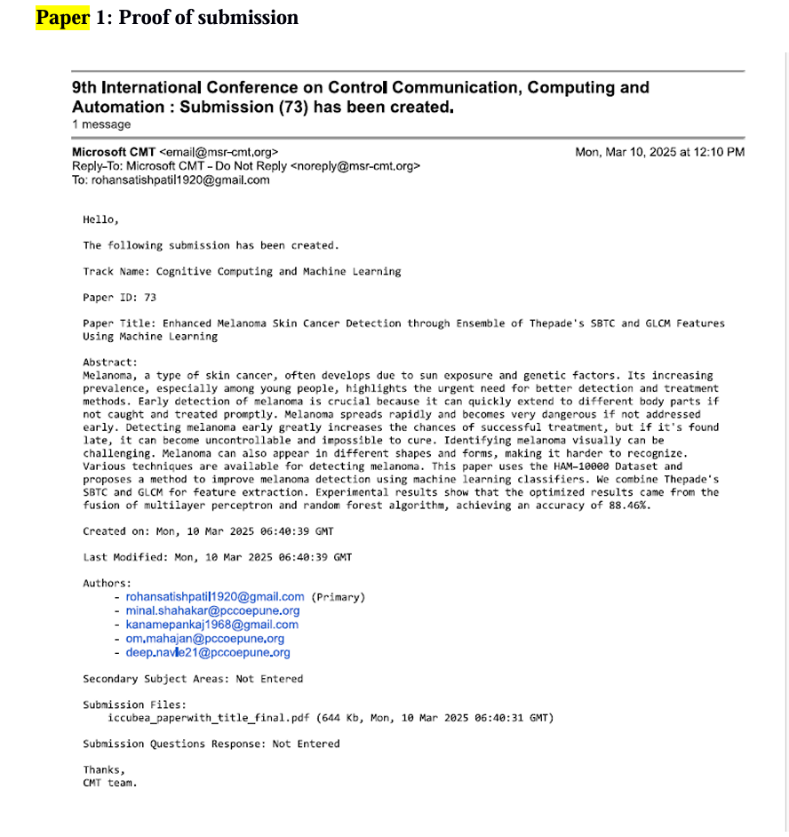

Slide 32
References
Indraswari, Rarasmaya, Rika Rokhana, and Wiwiet Herulambang. "Melanoma image classification based on MobileNetV2 network." Procedia computer science 197 (2022): 198-207.
S. D. Thepade and A. Aher, "Machine Learning Based Melanoma Skin Cancer Identification Using Feature Fusion of Thepade's TSBTC and Bernsen Thresholding," 2022 International Conference on Signal and Information Processing (IConSIP), Pune, India, 2022, pp. 1-6, doi: 10.1109/ICoNSIP49665.2022.10007471.
Mahmud, Faysal, et al. "An Interpretable Deep Learning Approach for Skin Cancer Categorization." arXiv preprint arXiv:2312.10696 (2023).
Shah, Aarushi, et al. "A comprehensive study on skin cancer detection using artificial neural network (ANN) and convolutional neural network (CNN)." Clinical eHealth (2023).
Raval, Dhatri, and Jaimin N. Undavia. "A Comprehensive assessment of Convolutional Neural Networks for skin and oral cancer detection using medical images." Healthcare Analytics 3 (2023): 100199.

Slide 33
Chanda, Dibaloke, et al. "DCENSnet: A new deep convolutional ensemble network for skin cancer classification." Biomedical Signal Processing and Control 89 (2024): 105757.
Akilandasowmya, G., et al. "Skin cancer diagnosis: Leveraging deep hidden features and ensemble classifiers for early detection and classification." Biomedical Signal Processing and Control 88 (2024): 105306
Midasala, Vasuja Devi, et al. "MFEUsLNet: Skin cancer detection and classification using integrated AI with multilevel feature extraction-based unsupervised learning." Engineering Science and Technology, an International Journal 51 (2024): 101632.
Kalpana, B., et al. "OESV-KRF: optimal ensemble support vector kernel random forest based early detection and classification of skin diseases." Biomedical Signal Processing and Control 85 (2023): 104779.

Slide 34
Thank you

